Slide 1
LinkHub REST API
Resource Management API

Slide 2
Where do you save your web resources?
Online study involves surfing the internet and visiting a lot of website to learn what they offer. As days pass on the longer you explore the more resources you have, and as time goes on you wish to go back to older resources to review the concepts again - the question is, where do you store the links to the older resources you wish to go back to in the future or wish to share with a friend?

Slide 3
LinkHub
That’s what LinkHub is here for. It helps you save and organize your resources in repositories. For instance, if you’re exploring on how to maintain a healthy life, you might search on physical workout and health diet, after you find the resources you want on those subjects you can save them on LinkHub repositories ‘workout’ and ‘health-diet’ - to visit any time you need them or share with a friend.

Slide 4
Technology and Architecture
In progress, LinkHub API is one of the services to offered by LinkHub and it is the main focus of this project.
LinkHub API is developed using Python programming language: Flask is the framework used to develop the LinkHub API endpoints, SQLAlchemy for the database integration and MySQL is the database management system client.

Slide 5
LinkHub database schema
LinkHub database tables
users
repositories
resources
tags
repository_tags
resource_tags
LinkHub database schema diagram

Slide 6
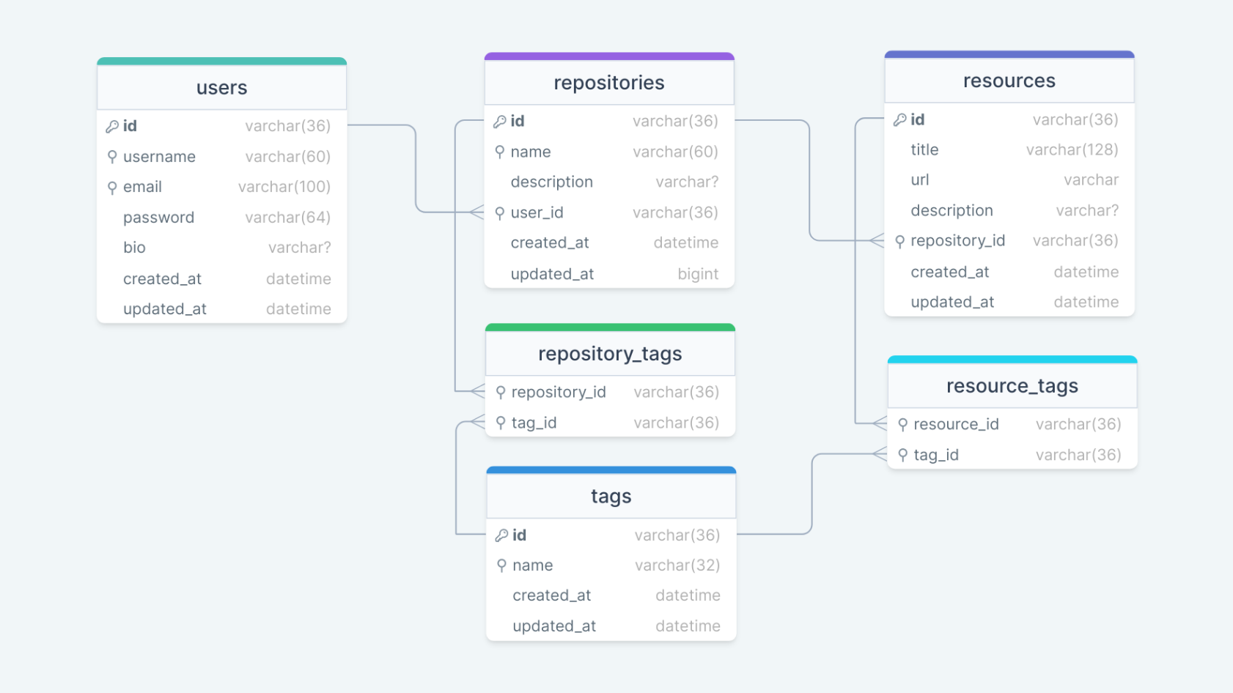

Slide 7
Core LinkHub REST API algorithms
LnkHub REST API used the linkhub package to perform create, read, update and delete (CRUD) operations using SQLAlchemy’s ORM model features.
LinkHub API uses JSON Web Tokens (JWT) for authentication and authorization of users and rate limiting to control the abuse of the API using a Flask framework extensions.
The linkhub package is a separate defined package from the api package where all the LinkHub REST API modules and mechanisms are defined.
LinkHub source code

Slide 8
Challenges
During development of LinkHub API there were lots of challenges, to list some of them:-
REST APIs have no dedicated standard structure or framework to use for development. The developer has to come up with ways to achieve REST API functionalities on their own by either developing it from scratch or using another technology available like flask extensions
REST API documentation is hard as it required not only understanding of openapi documentation standard but also learning the technologies like Postman or frameworks like openapi (Swagger) to be able to write the documentation.

Slide 9
Challenges Resolves
To overcome all these challenges. Defining custom endpoints in flask is the approach used to define the REST API endpoints. For the documentation Postman was used as it is easier and flexible to use than Swagger
Reference:
LinkHub API documentation using Postman

Slide 10
LinkHub API /users endpoint definition code snippet
A code snippet of the LinkHub /users endpoint definition that retrieves a list of all LinkHub users
In its definition we use linkhub package methods from storage module to retrieve the list of all users, then use flask’s module: jsonify to format return the list in JSON format.

Slide 11
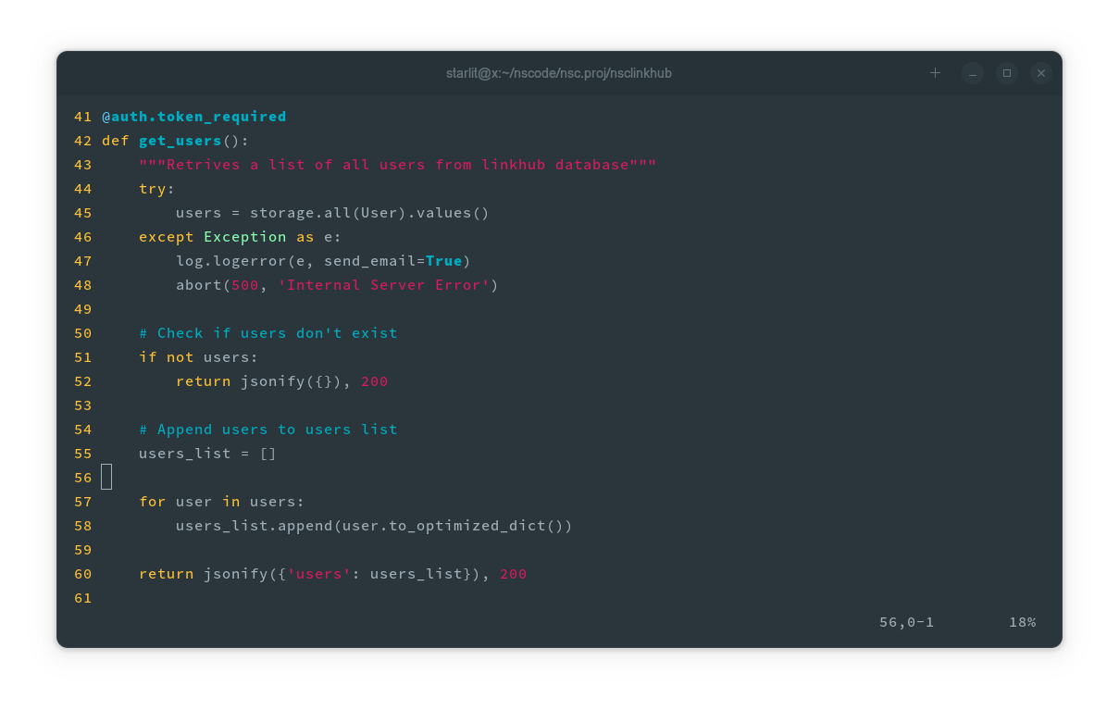

Slide 12
LinkHub REST API demo
The demonstration of LinkHub REST API can be done in Postman.
LinkHub API documentation and demonstration of all the methods a user needs are predefined in postman.
Reference:
LinkHub REST API documentation - click on ‘Run in Postman’ to import the nsclinkhub collection

Slide 13
Any Question?
What’s next for LinkHub?
The next step is to develop a developer web portal where developers who want to interact with the API for development purposes can register and get token for developers.
Developing the LinkHub web application for users to interact with and save their resources
Develop a chrome extension to easy the process of saving resources to repositories and to make it easy to use LinkHub extension as an alternative to bookmarking functionality in the web.

